Slide 1
Best Practice -- Hometowners
PURPOSE
  To Increase AFCEA Award Winner Recognition
  How?
    By sharing the good news with media at their…
      Hometown Papers
      Work Places
      Associations
      Alumni publications
      Fraternities/Sororities

Slide 2
Best Practice -- Hometowners
PROCESS
STEP 1 – PREPARE THE PACKAGES
BEFORE the Awards Ceremony…
Get information from award recipients
Write basic news release on each
  Lift text from Award justification section
  Add photo and caption
    Use AFCEA award photo or take one during ceremony
Tailor releases to specific media
  Usually need only to change headline and one paragraph!
Get recipients’ OK before sending out

Slide 3
Best Practice -- Hometowners
PROCESS (Con’t)
STEP 2: MEET THE MEDIA
AFTER the Awards Ceremony…
Personally establish a contact at each publication
  Determine their interest
  Explain what you’ll be sending
  Ask for confirmation they’ve received
  Request electronic/hard copy of whatever runs
Then, send ‘em out!

Slide 4
Best Practice -- Hometowners
RESULTS?
Over past 7 years, 144 releases went out on 44 winners
  Numbers on each varied between 1 and 6
  Editors’ response varied as well
    Very few were ignored
    Interest increased with winner’s importance within that community
      Some resulted in additional feature stories
      One even motivated a plaque marketeer!
Success enjoyed in all five areas.
  Here are examples…

Slide 5

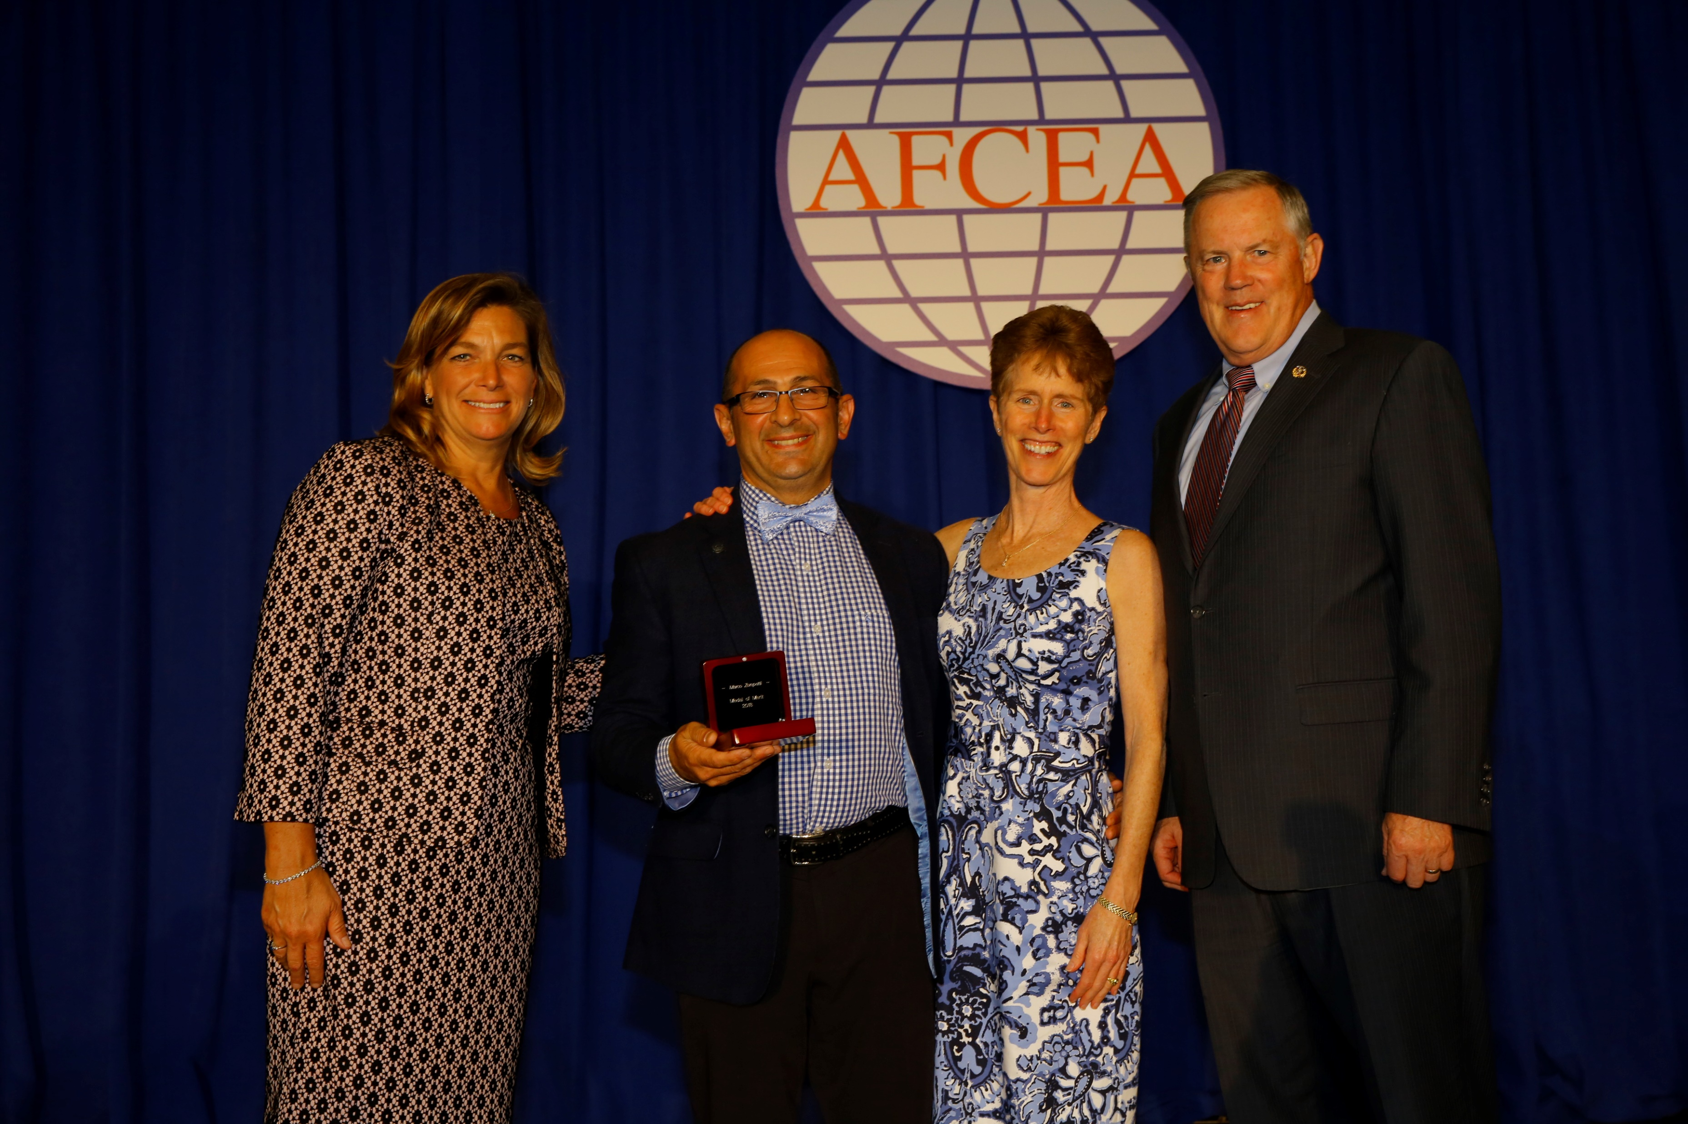
Best practice -- Hometowners
Hometown Papers
Posted May 27, 2018 at 5:10 PM Updated May 27, 2018 at 5:10 PM
AFCEA honors Marblehead resident Marco Zompetti with Medal of Merit
Marco Zompetti receives the AFCEA International Medal of Merit on May 14, 2018. From left: DeEtte Gray, CACI, AFCEA International Chair of the Board; Zompetti; Mrs. Tracey Zompetti; and Lt. Gen. Robert M. Shea, USMC (Ret.), AFCEA President and CEO. [COURTESY PHOTO/AFCEA]

Slide 6
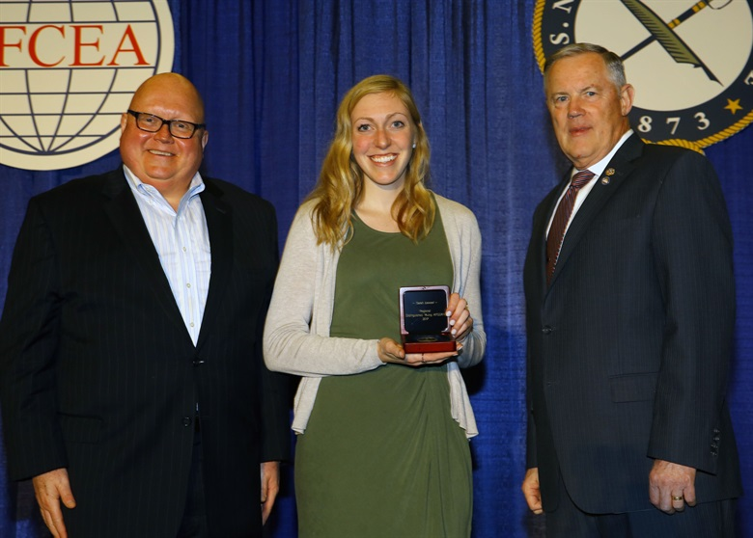
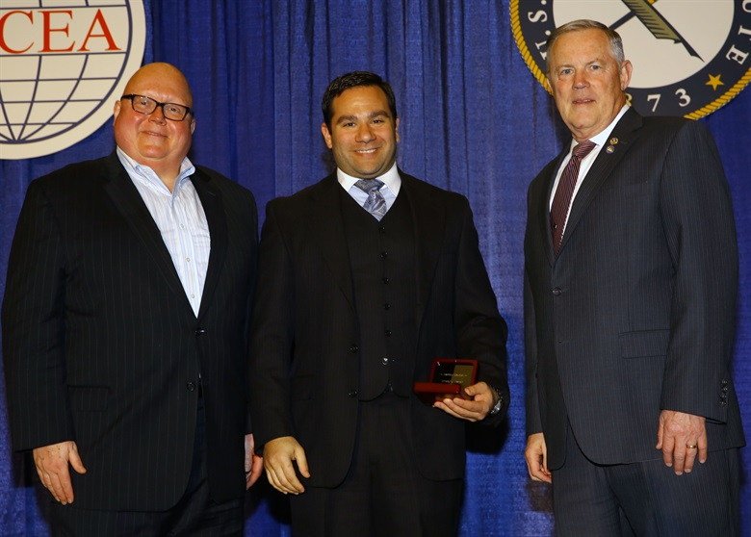
Best Practice – Hometowners
Work Places

Slide 7
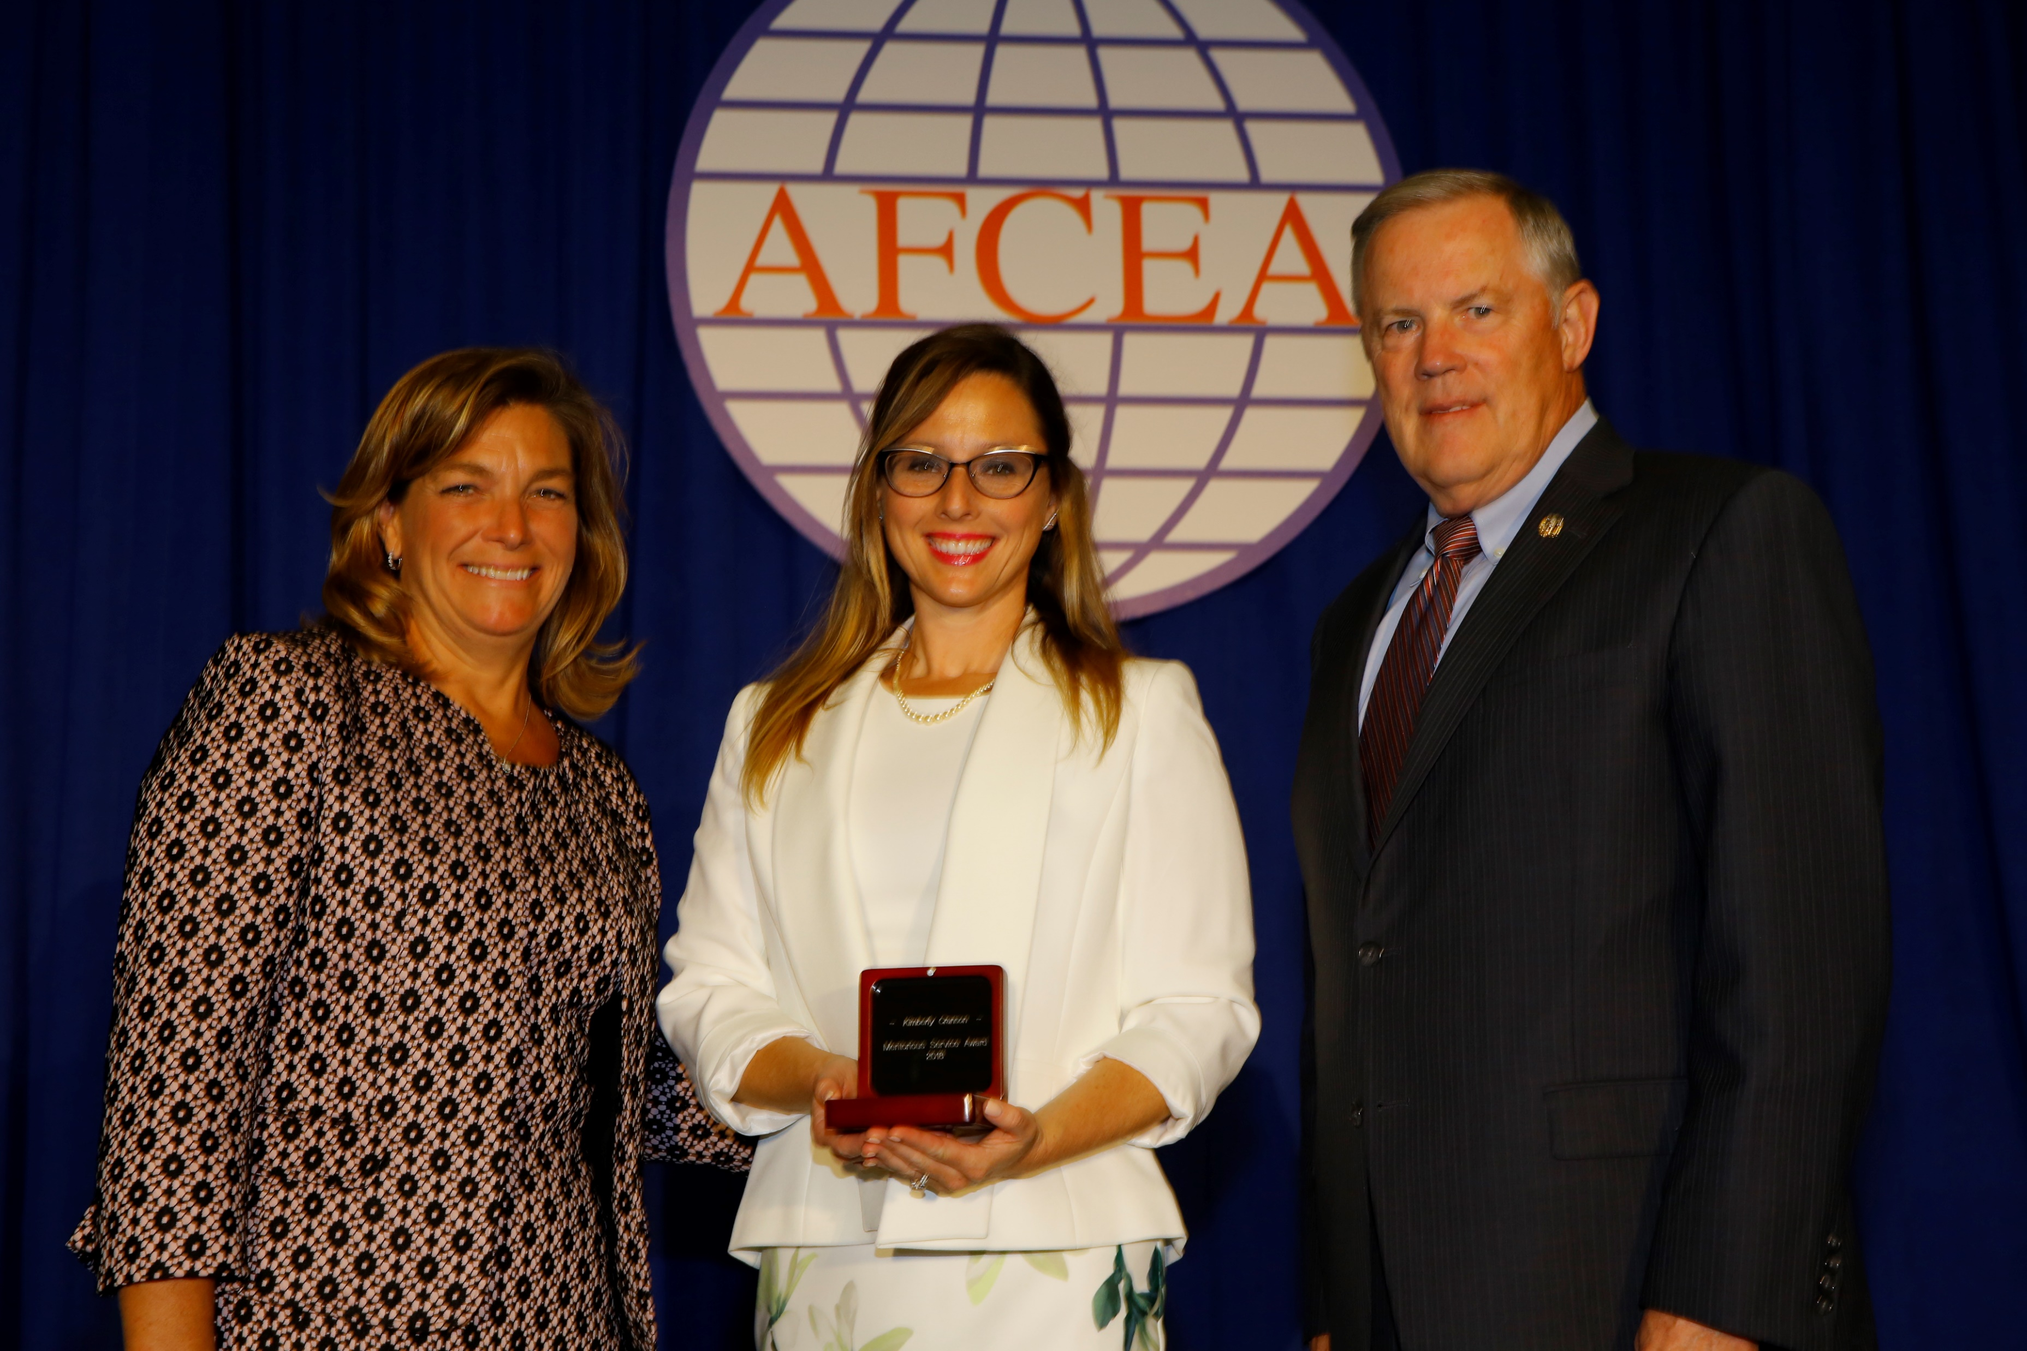
Best Practice -- Hometowners
Associations

Slide 8

Best Practice -- Hometowners
Fraternities

Slide 9
Best Practice -- Hometowners
SUMMARY
Our Hometowner Program has done Lexington-Concord proud!
  With relatively little up-front effort, it’s been…
    A win for award recipients
    A win for the Chapter
    A win for AFCEA
Happy to take any questions AND
help anyone wanting to get started.

